Slide 1
Agile Estimation and Planning
Ben Dewey
Twitter: @BenDewey
Email: ben @bendewey.com
Notes:
Don’t talk about your credentials, no one really cares, and you have too much content to cover.

Slide 2

How long does will it take
to land a space shuttle
on the moon?

Slide 3
What is Estimation?
Wikipedia: Estimation is the calculated approximation of a result which is usable even if input data may be incomplete or uncertain.
In software engineering, estimation is the process of speculating the amount of effort required to complete a task or set of tasks.
Notes:
In a nutshell: We’re going to use incomplete and uncertain information to approximate our work efforts before we undertake a big project, and this is going to be valuable to us, I promise.

Slide 4
Why Do We Estimate Work?
Resource Planning
Cost vs. Benefit Analysis
Coordination with other projects
What else?
Notes:
Ask for suggestions why we might estimate.
Time: 0:02

Slide 5
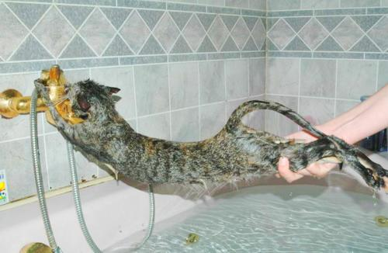
Why Do We Really Estimate Work?
To avoid stressful situations!!
Notes:
Typically, poor (or no) estimation leads directly to overworking as deadlines loom. Then we cut corners and wind up with messy software that is difficult to maintain.

Slide 6
Common Problems with Estimation
Calendar time is not a measure of effort.
Manager: “How long will this take?”
Engineer: “Do you mean if I worked full time on JUST THIS, or with my other work?”

Slide 7
Common Problems with Estimation
One’s mountain is another’s molehill.
Manager: “Joe said it would take three weeks.”
Engineer: “What!? He’s wrong, the MountainCrusher library already does that, and I have a copy right here.”

Slide 8
Common Problems with Estimation
Estimates have a short shelf-life.
Manager: “Why is this taking so long!? You said this would only be two days!”
Engineer: “But I said that 4 months ago! The current system architecture makes this feature much harder to build.”

Slide 9
Common Problems with Estimation
It is easier to estimate the near future.
Manager: “How long will it take to do Z?”
Engineer: “I haven’t even done B yet!”
Manager: “How long for B?”
Engineer: “Hmm… Maybe a week or so.”

Slide 10
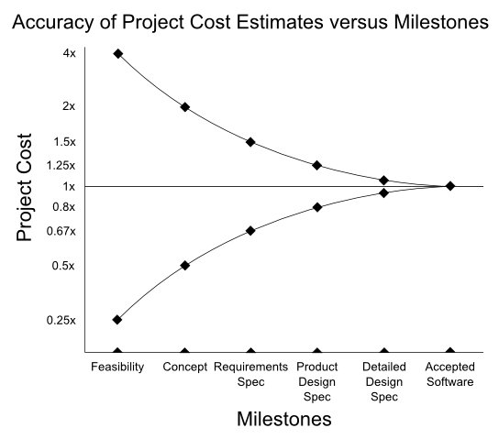
Cone of Uncertainty

Slide 11
Agile estimation avoids these common problems (and more) by taking a more practical approach to estimating work.
Notes:
By practical, I mean ‘proven to work better by trial and error’!

Slide 12
The Agile Estimation Process
Define your work (User Story Modeling)
Estimate collaboratively (Planning Poker)
Use a unit of work, not time (Story Points)
Increase accuracy with relative sizing
Measure real progress (Velocity)
Adapt to change (Re-estimation)
Notes:
I’ll present some best practices for following this process.
Time: 0:08

Slide 13
User Story Modeling
Narrative:
(Who) wants (what) so that (why)
A story is a conversation starter, and gets more detailed over time
Notes:
Who – Who will benefit from the feature
What – What is the feature
*Why – Why is most important to help empower engineers to make value decisions based on an understanding of the motivation behind the story.

Slide 14
User Story Modeling
Good stories satisfy INVEST:
Independent
Negotiable
Valuable
Estimable
Small
Testable
GOOD:
Billing wants to see a summary page of all unpaid accounts, so that they can collect payments.
BAD:
Users want rounded corners on the search button.
Our company wants a new website to increase sales.
Notes:
Independent – Can be done in any order without depending on each other.
Negotiable – Leaves some detail up for debate about implementation or approach
Valuable – Offers users real value
Estimable – Has enough information to be able to estimate it
Small – Large pieces of work need to be broken down
Testable – Has well defined criteria for testing that the work is DONE.

Slide 15
User Story Modeling: Acceptance Criteria
Story: Users want to import music from a folder so that they can include their own music in the library.
Given a user is on the "Library Folder" screen
When the user clicks Add Then the Add Folder screen shows a radio option for "Search for Music”
When the user saves a folder with "Search for Music" checked Then the folder is added to the list of folders.
Notes:
Only include necessary detail. AND is also acceptable language.
Key Point: This formatting helps you better define your work and avoid communication problems.
Break for questions about user stories and defining your work!
Time: 0:18

Slide 16
Story Points
… are an arbitrary unit of size/complexity that we use to estimate user stories in lieu of calendar time.
An alternative unit: Ideal Days
Notes:
Some people use Ideal Days – I advise against it because as confusing as a new term is, it’s worse to try to redefine a term people think they already understand. I promise that if you use Ideal Days, people will think this means one calendar day, and that is INCORRECT.

Slide 17
Planning Poker - Preparation
After all the stories are written, prioritize! We will estimate the high priority stories first.
Pick a scale
Examples: Fibonacci sequence or Powers of 2
Pick a baseline story to set the unit size
Make the smallest story 1 unit OR
Choose a midsize story
Notes:
We use nonlinear scale to account for having less detailed information about bigger pieces of work. These scales lose resolution as they increase and work very well in practice.

Slide 18
Planning Poker - Gameplay
Have the story owner give a brief overview (1 min)
Everyone chooses one estimate (KEEP IT SECRET)
On the count of 3, we reveal our estimates!
Do we agree?
YES – We’re done! Move on to the next story.
NO – The high and low outliers defend their positions in a short open discussion
Record any assumptions we need to make
Repeat steps 2 - 4 until we (mostly) agree
Notes:
Break for questions about Planning Poker!
Time: 0:30

Slide 19
Mock Poker
Company:
Robotics Inc. sells sensors and circuit boards for electronic enthusiasts. They have an ecommerce website where they sell the products.
Story:
“The User wants to be able to see all the categories so that they can select a category to view its products.”
Acceptance Criteria:
Given a user is on the home page
When the page loads then the user will see a list of categories.
When the user clicks a category then they will go to a product details page.

Slide 20
Story Backlog
This is just a bucket for all your stories
Keep it prioritized and organized!
Pull estimated stories off this list to create an iteration plan
Notes:
Can use note cards or a tool like Rally, Mingle, Lighthouse, FogBugz, Bugzilla to keep track of your backlog.

Slide 21
Iteration Plan
Usually 2-4 weeks
Do high risk / high priority work first
How much can you do in one iteration?
Make sure everyone can be kept busy
Compare with previous work, if possible
If not, guess, it’s OK to be wrong!
Notes:
Time: 0:33

Slide 22

Consistancy
& Accuracy

Slide 23
Team Velocity
Velocity is the number of points you completed in previous iterations
Over time this number will stabilize (usually after 3 iterations)
Total Points / Velocity * Iteration length =
Calendar Time!
Notes:
Break for questions about Iterations and Velocity!
Time: 0:37

Slide 24
Re-estimation
Re-estimate when you have new information that affects your previous estimates
Review your upcoming story estimates before each iteration, do they still make sense?
Re-estimate if you change a story
NEVER change an estimate after a story has entered development!
Notes:
You don’t change story estimates after dev starts because you want your estimation to happen in a consistent way, before you start working. Estimates are ESTIMATES, not a record of actual time.
Questions?
Time 0:40

Slide 25
Lab - Planning Poker
Break up into groups
Define roles you will represent:
Business users (2) and team members (design, dev, QA, etc)
We work at Expedia.com and have 20 million customers. You are doing an add-on for the Customer Service team. Do a planning poker for this user story:
“Customer Service wants to search for customers by their first and last name, so that they can quickly retrieve customer information when on a call.”

